Slide 1


Slide 2

Computer Organization and Assembly Language (CS2523) – Section # 4
Department of Computer Science,
Capital University of Science and Technology, Islamabad
Fall Semester, 2022

Slide 3
Lecture Outlines
Introduce Yourself
Course Contents and Organization
Instructor Information
Course Motivation
Aims
Literature
Miscellaneous

Slide 4
Introduce Yourself
Your good name
Your favorite course till now
Your expectation from course
Your expectation from teacher

Slide 5
Course Contents and Organization
See outline on Portal for
Course Contents
Evaluation Criteria

Slide 6
Course Objectives
Course learning Outcomes (CLOs):
At the end of this course, the students should be able to:
CLO1: Define concepts in the design of micro processor as state machine and designing its data path and its controller. [C1- Remembering]
CLO2: Describe how the basic units of the Intel 8088 architecture work together to represent Integer Numbers, Floating Numbers and register representation inside the microprocessor. [C2- Understanding]
CLO3: Implement assembly programs of intermediate complexity using the intel 8088 architecture. The student should also be able to convert intermediate complexity program in high level language into assembly code. [C3- Applying]

Slide 7
Course Objectives
CLO / PLO Mapping
PLO CS | CLO:1 | CLO:2 | CLO:3
PLO:1 (Knowledge) | ✓ | ✓
PLO:2 (Problem Analysis)
PLO:3 (System Design) |  |  | ✓

Slide 8
Pre-Requisites
CS1133: Introduction to Programming
Thirst for knowledge…
Notes:
888

Slide 9
Course Information
The main objective of this course is to introduce the organization of computer systems and usage of assembly language for optimization and control.
Emphasis should be given to expose the low-level logic employed for problem solving while using assembly language as a tool.
The course will be delivered with the consideration of the one of the most famous microprocessors of Intel. i.e. iAPX88 and our assembly language programs will be implemented with this architecture.

Slide 10
Course Motivations
A very important aspect in assembly will be looking at the working of a hidden but very important aspect of a program which is stack and the clear understanding of this topic will help to understand many topics in the Operating System Course.
At the end of the course the students should be capable of writing moderately complex assembly language subroutines and interfacing them to any high level language.

Slide 11
Aims
Identify the major components of computer architecture, and explain their purposes and interactions.
Simulate the internal representation of data, and show how data is stored and accessed in memory. Explain the relationships between hardware architecture and its instruction set, and simulate micro-programs.
Explain the Instruction Execution Cycle.
Explain the differences and relationships among high-level, assembly, and machine languages.

Slide 12
Aims
Write well-modularized computer programs in an assembly language, implementing decision, repetition, and procedure structures.
Write moderately complex assembly language subroutines and interfacing them to any high level language. Use a debugger, and explain register contents.
Simulate the system stack as it is used for procedure calls and parameter passing.
Explain how editors, assemblers, linkers, and operating systems enable computer programming.
Explain various mechanisms for implementing parallelism in hardware/software.

Slide 13
Instructor Information
Ms. Tayyaba Zaheer
Contact:
Office:
Block M 1st Floor, CS Faculty Offices
Email:
tayyaba.zaheer@cust.edu.pk
Counseling hours(by prior email)
MON | 11:30 AM-01:00 PM
WED | 11:30 AM-12:30 PM

Slide 14
Instructor Information
Industrial Experience
Whizpool
Jolta Technologies
PRAL
Pakistan Army
Teaching Experience
Barani
SEECS, NUST
IQRA
CUST

Slide 15
Literature
Books
Text Book(s):
Assembly language for x88 processors, Belal Hashmi
Reference Books(s):
Assembly Language for Intel based computers, Kip Irvine, 4th edition
Computer Organization and Architecture, William Stallings, 11th Edition, Pearson
Programming the 8086/8088, Coffron, James W.

Slide 16
Literature
Reading other books is also recommended for better understanding of the topics covered.

Slide 17
Tentative Grading
Exam Type | Percentage(%)
Quizzes/Class-Tests | 20
Assignments | 20
Mid Term | 20
Final Term | 40

Slide 18
Teaching Methodology
Lectures will be delivered using white board (most of the time), sometimes we may use slides / multimedia.
Class participation will be encouraged.
Ask question immediately when it comes to your mind.
Any difficulty in the lecture must be pointed out in the coming lecture (immediately after the lecture).
It is strongly advised to concentrate and participate in the discussions during class hours, because you may not find the explanation with same examples in the book.
Be on time, as there may be a quiz in the start of the class.

Slide 19
Consultation
You may contact via email.
There will be a team on Microsoft Teams for discussions and assignments.
All of you will be added in the team.

Slide 20
General Guidelines
Lectures material will be available on CUST intranet:
\\fs\lectures$\Tayyaba Zaheer\2. COAL-CS2523(S4)5th\
Submit assignments on Microsoft Teams
Further remarks:
Please interrupt the lecture if you have questions, Any other disturbance will not be allowed
Use of mobile phones is strictly prohibited during lecture
Feedback is welcome

Slide 21
General Guidelines
Visit Portal and Network Server folder regularly for updates
Start working on projects/assignments right from the first day.
Come prepared in the class
Read book (s)
Remain attentive during the class. Ask questions.
I will ask questions very often
Maintain proper discipline in the class. I will be very strict on disciplinary matters

Slide 22
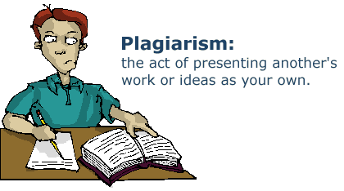
General Guidelines
Quiz
Announced
Un-announced
Assignments
All assignments will be graded
Cheating/plagiarism
Zero tolerance policy!
Partial and genuine work can get marks but plagiarized work would not be accepted at all.
There can be a penalty on plagiarism

Slide 23
Personal Integrity
I act with honesty, integrity, and respect for others.

Slide 24


Collaboration Policy
Explaining a concept to someone in another group
Discussing algorithms/testing strategies with other groups
Helping debug someone else’s code (in another group)
Searching online for generic algorithms (e.g., hash table)
Sharing code or test cases with another group
Copying OR reading another group’s code or test cases
Copying OR reading online code or test cases from prior years or semesters
Strict actions would be taken against offenders

Slide 25
Attendance Policy
75% required to take Final Exam
Any missed class is your own responsibility
Missed quiz/assignment will follow university protocol

Slide 26
Tools We Will Use in Class
NASM
EMU 8086 in Lab

Slide 27
Class Etiquettes
Respect each others
Keep your mobiles switched off
Be careful of class timing
Late comer may be not allowed
Delay talks with colleagues
Ask questions at the end of a lecture
Avoid interruption in class

Slide 28
Open Door Policy
I would like the course to be informative and enjoyable.
Let us know what you find just, good and interesting about the course.
Let us know sooner if you feel something could be improved.
See us, send an e-mail, or leave us a note.

Slide 29
Why take CS2523?
Some of you will actually design and build operating systems or components of them.
Perhaps more now than ever
Many of you will create systems that utilize the core concepts in operating systems.
Whether you build software or hardware
The concepts and design patterns appear at many levels
All of you will build applications, etc. that utilize operating systems
The better you understand their design and implementation, the better use you’ll make of them.

Slide 30
Why take CS2523?
This course is about computer organization and assembly languages.
You might wonder why learning assembly languages.
After all, who will write assembly programs these days.

Slide 31
Why take CS2523?
Actually, people still write assembly for
faster codes (compiler is not as smart as men yet),
smaller codes (for devices with limited amount of memory such as mobile devices) and
specific architectures (in which there are not even compilers, for example, early GPUs).
With these in mind, in addition to the fundamentals about assembly programming, this course emphasizes on code optimization techniques on writing fast and small codes.

Slide 32
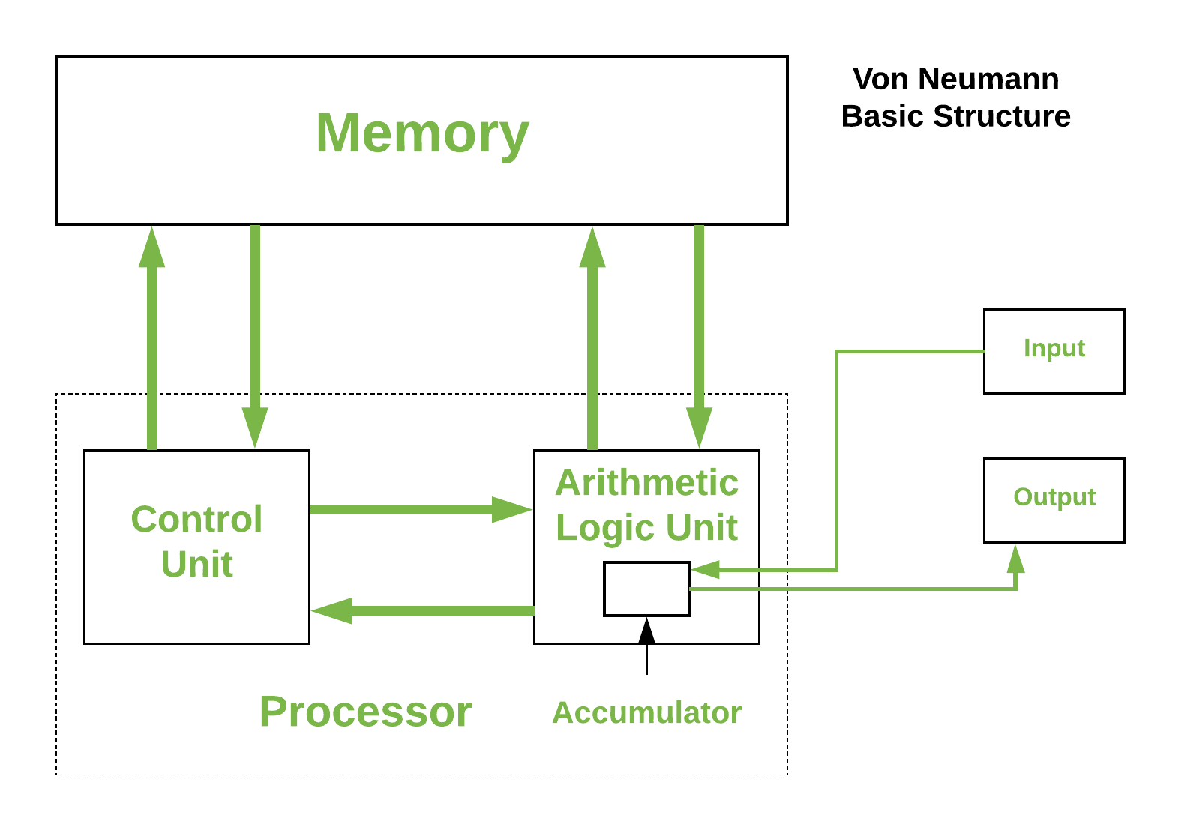
Why take CS2523?

Slide 33
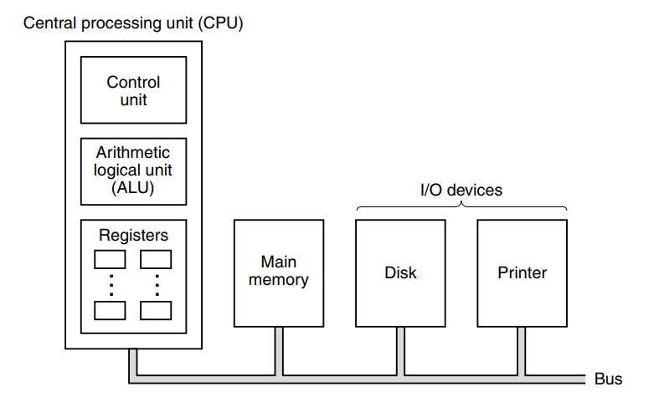
Why take CS2523?

Slide 34
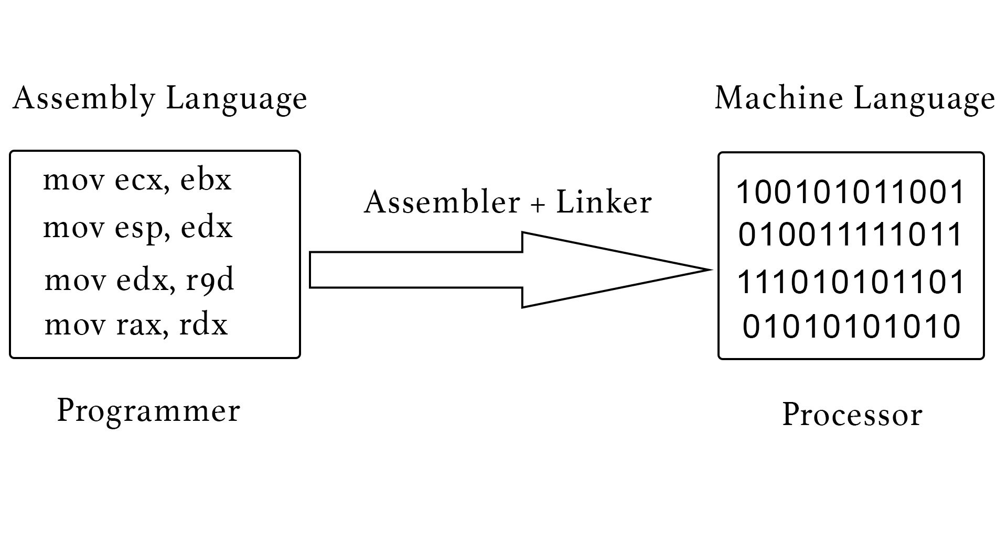
Why take CS2523?

Slide 35
The End Thanks for Your Attention

Slide 36
Questions

